Slide 1
Entities Relationship Model
Dr. Anand Bihari
SJT Annex- 203N
anand.bihari@vit.ac.in

Slide 2
Entities Relationship Model
The ER data mode was developed to facilitate database design by allowing specification of an enterprise schema that represents the overall logical structure of a database.
The ER data model employs three basic concepts:
entity sets,
relationship sets,
attributes.
The ER model also has an associated diagrammatic representation, the ER diagram, which can express the overall logical structure of a database graphically.

Slide 3
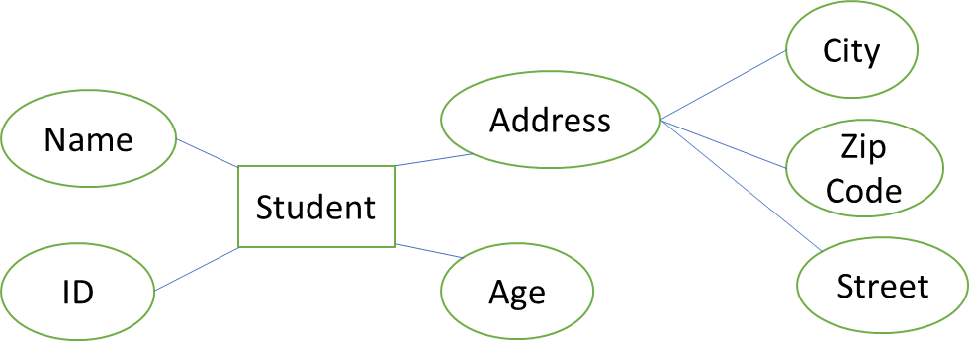
Entities Relationship Model
It is defined to represent the relationship between different stakeholders.
Here Student is an entity.
ID, Name, age and address are attributes.
Address is also an entities.

Slide 4
Entities and Attribute
An entity is an object that exists and is distinguishable from other objects.
Example: specific person, company, event, plant
An entity set is a set of entities of the same type that share the same properties.
Example: set of all persons, companies, trees, holidays
An entity is represented by a set of attributes; i.e., descriptive properties possessed by all members of an entity set.
Example:
instructor = (ID, name, salary ) course= (course_id, title, credits)
A subset of the attributes form a primary key of the entity set; i.e., uniquely identifying each member of the set.

Slide 5
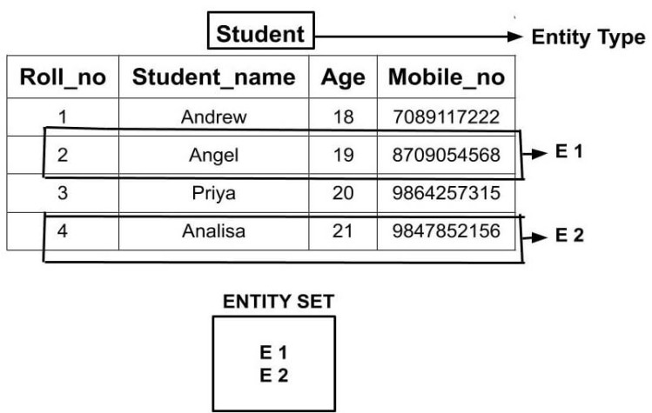
Entity Sets

Slide 6
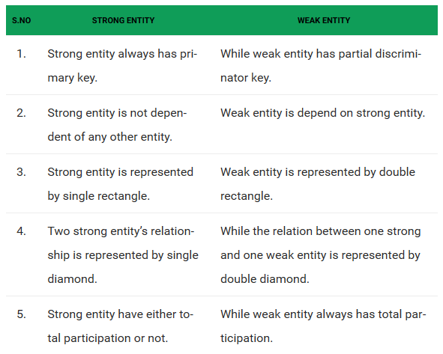
Entity type

Slide 7
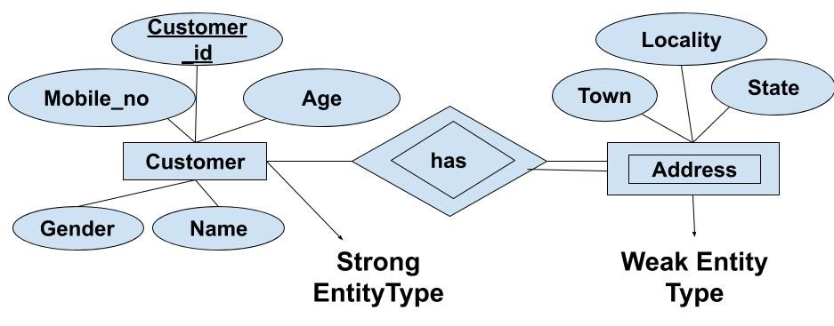
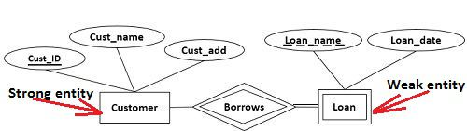

Slide 8
Attribute types
Composite vs simple attributes
Single valued vs multi valued attributes
Stored vs derived attributes
Null attributes
Complex attribute

Slide 9
Composite Attribute
Composite attribute can be divided into smaller subparts, which represent more basic attributes with independent meaning
Example: Address(street address(number, name, door no.), city, state,zip),
Qualification( degree name, year, college name)

Slide 10
Single valued vs multi valued attributes
Simple attribute
Attributes are indivisible or atomic values
Example: phone number
Single value attribute
Single value for a particular attribute
Example: age, place of birth
Multi Value attribute
If multiple values are there for a particular attribute.
Example: degree, course_enrolled, email id.

Slide 11
Stored vs derived attributes
Two ( or more) attributes are related
Example:
age and DoB attributes of a person.
Basic salary and total salary.
Null Value Attribute
Example: college degree (if person did not complete the degree, then the value will be null)
Complex Attribute
Composite and multi valued attributes are nested.
Example: {Phone address( phone(area code, phno))}

Slide 12
Key Attribute
An attribute or collection of attributes whose values uniquely identify an entity in the entity set
Example: reg_no, emp_id, hotel_id

Slide 13
Keys
Key is an attribute or collection of attributes that uniquely identifies an entity among entity set.
For example, the roll_number of a student makes him/her identifiable among students. There are mainly three types of keys:
Super Key − A set of attributes (one or more) that collectively identifies an entity in an entity set.
Candidate Key − A minimal super key is called a candidate key. An entity set may have more than one candidate key.
Primary Key − A primary key is one of the candidate keys chosen by the database designer to uniquely identify the entity set.

Slide 14
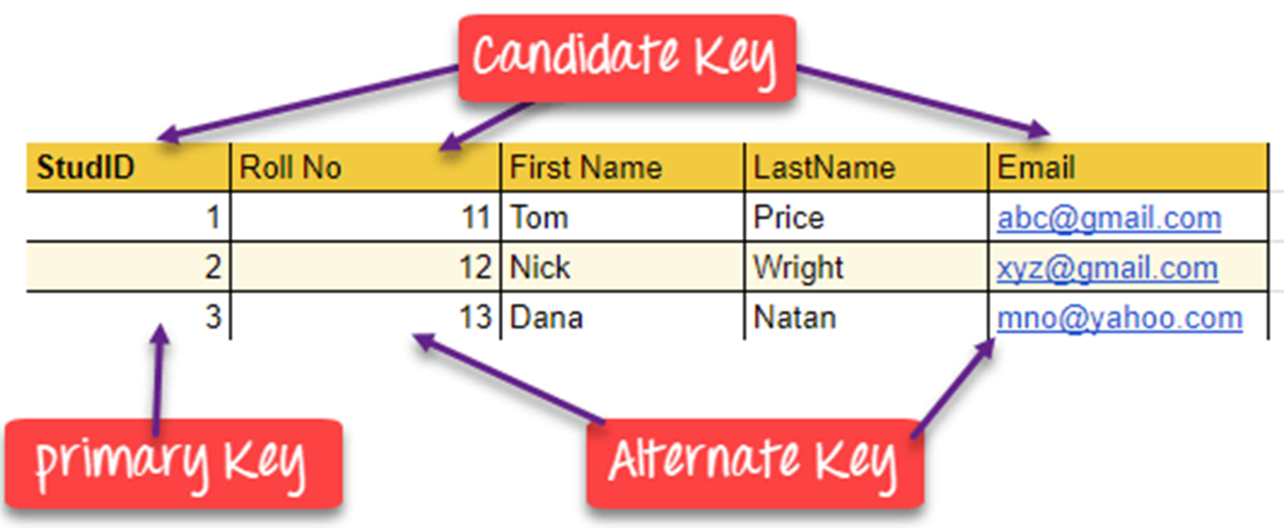

Slide 15
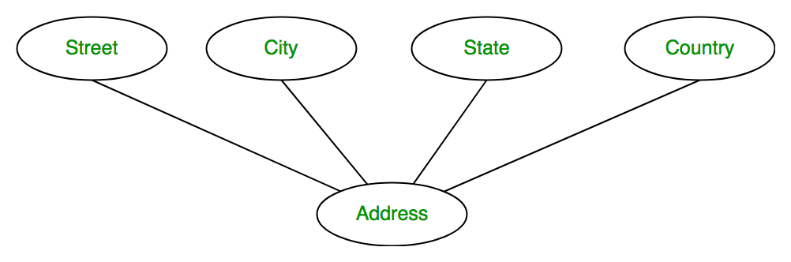
ER-Diagram Symbol and meaning
Entities or Strong entities Weak entities
(having key attribute) (No key attribute)
Attribute Multi-valued attribute Key Attribute
Derived attribute Composite attribute
Key
Age

Slide 16
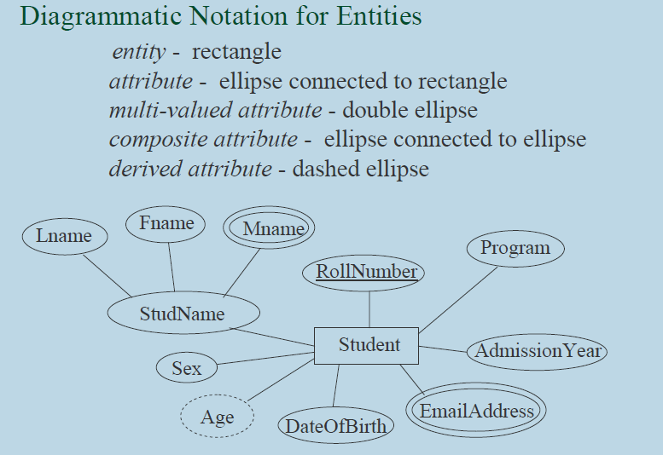
Entity- Relationship Model

Slide 17
ER-Diagram
Design an ER schema diagram of Library management system.
Design an ER schema diagram of student information management system.

